Slide 1
LESSON FIVE
TOPICS: HOW TO CREATE THE SHOOT METHOD AND MANAGE THE BUG ASSOCIATED WITH CLICKING ON THE SKY VIA THE USE OF BACKDROPS.

Slide 2
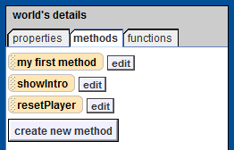
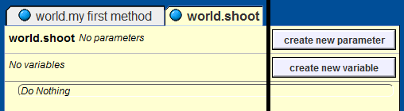
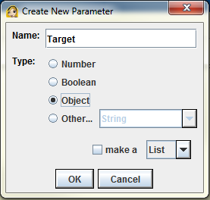
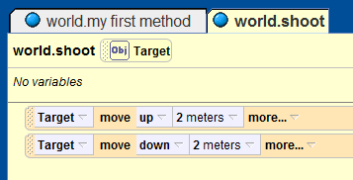
Step 1: Create the Shoot Method
Create a new method for the world object titled “shoot”.
In the code editor window for the shoot method, click on “create parameter” to add a parameter to the shoot method
Name the new parameter “Target”, and set its type to “Object.”
Drag the shoot.Target parameter into the code text and select “move up 2 meters.”
Add a one more line of code that says “move down 2 meters.”

Slide 3
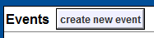
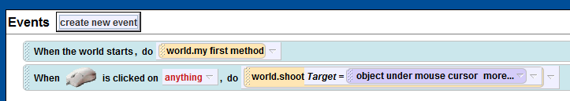
Step 2: Create the Click-On Event
Click on the “create new event” button.
Select “When mouse is clicked on something”
Drag-and-drop your newly created “world.shoot” method after the “do” command in your new event.
From the pop-up menu, select “expressions → object under the mouse cursor.”
Notes:
After the students complete steps 1 through 3, instruct them to play their Alice world and click on a few of the objects. Ask them what happens? (The objects should move up and down.) Then ask them to click on the sky. What happens? (Alice should throw an error.) The error is caused by Alice trying to call the shoot method, but not having a variable (object/model) to pass to the shoot method. If a method is passed an invalid parameter then it will crash the program.

Slide 4
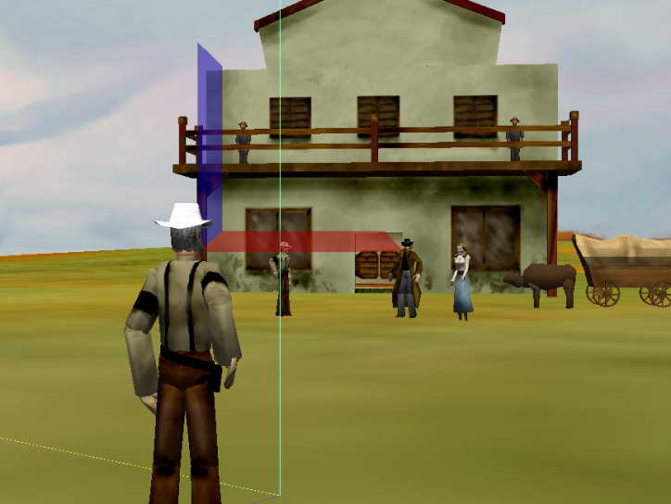
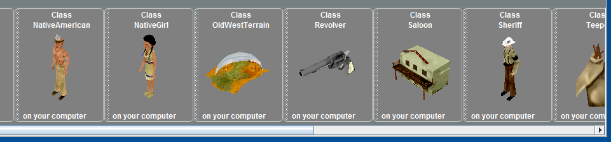
Step 3: Add the Old West Terrain
Find the “Old West Terrain” from the Old West gallery and add it to your world by clicking on it. Do not drag the Old West Terrain into your world!
Set the isFirstClass property for the Old West Terrain to false.

Slide 5
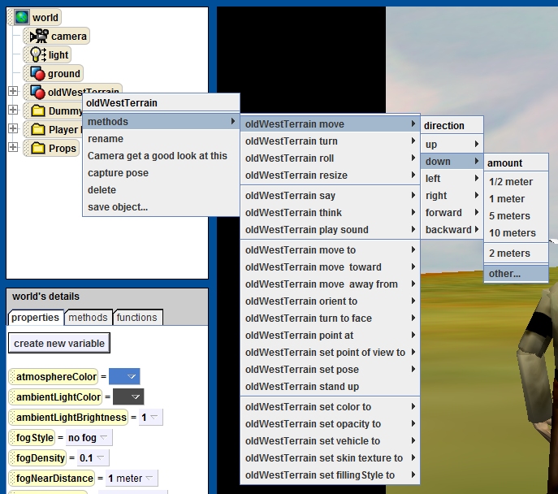
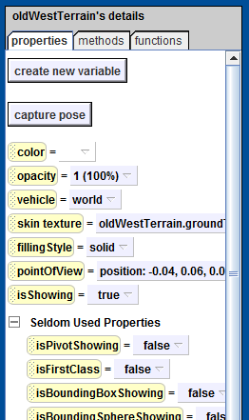

Step 4: Clean Up Your World
Programmatically move the Old West Terrain down 0.05 meters.
Move the Old West Terrain to the Props folder.

Slide 6
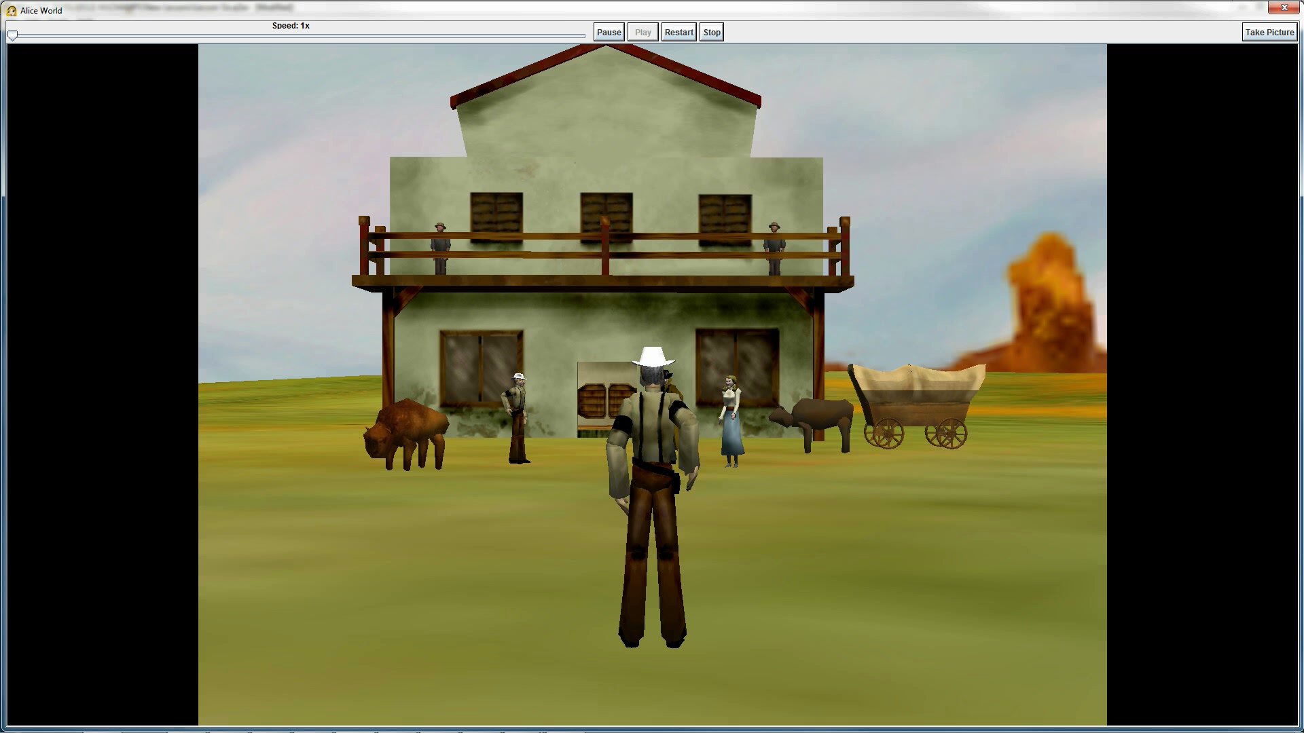
Final Scene

